Slide 1

The latest and greatest from Azure Service Bus
Eldert Grootenboer

Slide 2

Speaker Bio
Eldert Grootenboer
He/Him
Program Manager - Azure Service Bus
@egrootenboer
servicebuspm@microsoft.com

Slide 3

What to expect?
Quick introduction
Recent releases
Coming soon
On the roadmap
How do we build this

Slide 4

Azure Service Bus

Slide 5
What is Azure Service Bus?
Platform-as-a-Service Queue and PubSub message broker
Fully managed
AMQP 1.0 and JMS 2.0 compliant
Polyglot Azure SDK
Industry-leading reliability and availability
Integration with other Azure services
Notes:
Platform-as-a-Service Queue and PubSub message broker
Fully managed: You use the features, Azure deals with everything else
JMS 2.0 and AMQP 1.0 standards compliant
Polyglot Azure SDK and cross-platform client support
Industry-leading reliability and availability
Integration with other Azure services
Simple to use from Functions and Logic Apps
Idiomatic language support
.NET
Java
JMS 1.0 and 2.0
Azure SDK for Java
Python
Typescript
Go
Integration with other Azure services
Event Grid
Logic Apps
Azure Functions
Power Platform
Dynamics 365
Stream Analytics

Slide 6
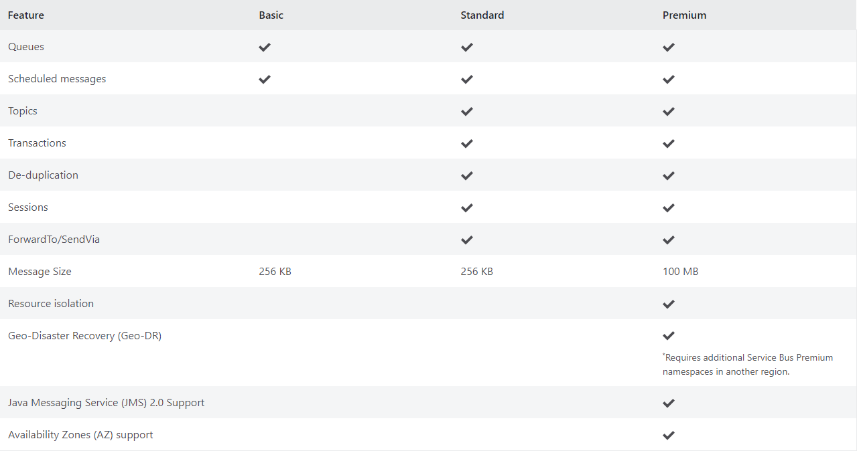
Messaging your way
*
* Meta-data only
Notes:
Scheduled delivery
Time To Live
ForwardTo
Defer
Sessions
Batching
Auto-delete queue on idle
OnMessage
Duplicate detection
Actions
Transactions
Poison message handling

Slide 7










Azure Messaging Platform
AMQP
JMS
Connect apps on an enterprise message queueing and pub-sub platform using open protocols including JMS 2.0​
Message Queue Broker
Azure Service Bus
Elastic Pub-Sub Broker​
Publish and subscribe MQTT messages and HTTP push and pull for delivery of discrete events​
>75% of S500 customers use 2 or more of our messaging services
Azure Event Grid
Event Stream Engine​
Cloud-scale, low latency streaming platform supporting Apache Kafka and AMQP clients and services​
Azure Event Hubs
Event Stream Processor
Real-time stream processing and analytics engine with rich development tools and low/no-code editor experiences​
Azure Stream Analytics

Slide 8

Recent releases

Slide 9
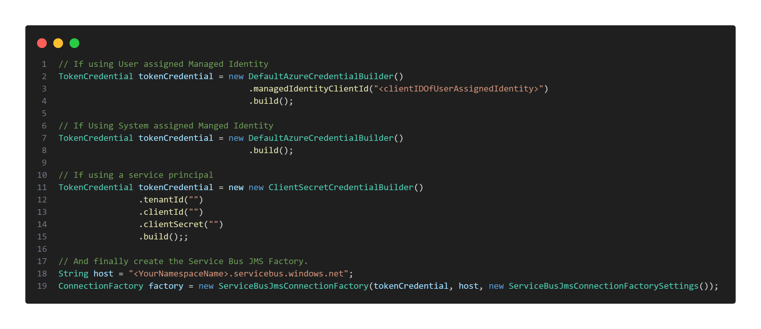
Passwordless connections for JMS clients (GA)
Authenticate using AAD for JMS 2.0
Use service principals, system-, or user-assigned managed identities
Package available on Maven (azure-servicebus-jms – 1.0.0)
Notes:
Demo

Slide 10
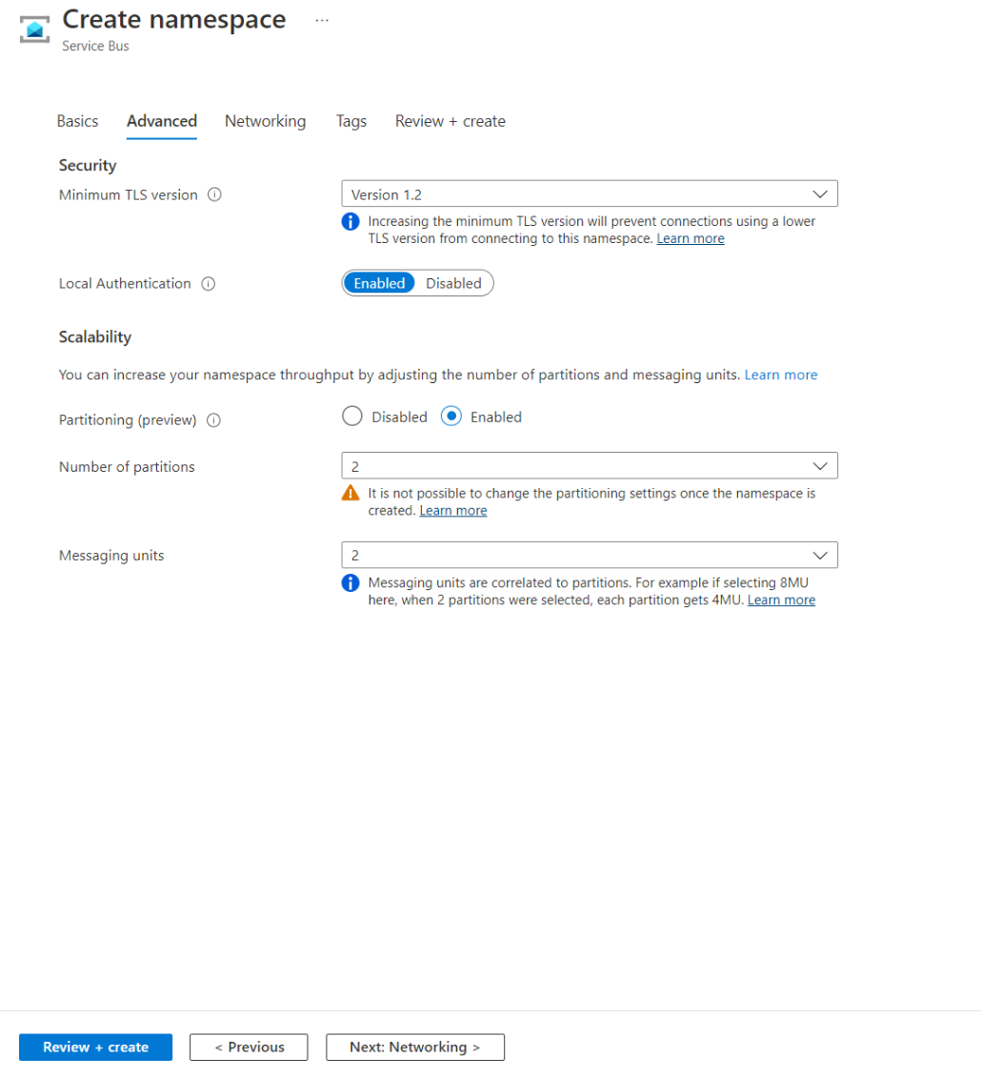
Partitioned namespaces & Consistent low latency entities (Public Preview)
Introducing partitions on Service Bus Premium
Allows for much higher scalability by allowing for multiple partitions in Premium namespaces
Focuses on high throughput scenarios, where absolute order and message distribution are less important
Relative order is still preserved
Order can be enforced using partition keys or sessions
Consistent low latency on your entities
Multi-tiered storage as we move to Local Store
Vastly improves reliability
Notes:
Demo
Enable configuration of partitions on namespace creation.
When creating a namespace, the customer should be able to specify how many partitions should be available for that namespace.
Allow scaling between 1 and 16 partitions.
Customers should be able to set a minimum value of 1 partition, and a maximum of 16. Each step either doubles or halves the number of partitions. Note: Initially the maximum number of partitions will be 4, due to capacity restraints.
Allow scaling between 1 to 16 MU.
Customers should be able to set a minimum value of 1 MU, and a maximum of 16. Each step either doubles or halves the number of MUs.
What this value be for a legacy premium entity with 2 partitions? In legacy premium entity we supported only 2 partitions.
If a namespace was created with 2 partitions, it will remain 2.
Local Store
Multi-tiered storage model where the first layer is local storage which is on the commitment path but overflows into Storage asynchronously in the background.
Allows us to reduce reliance on storage for the primary commitment path which takes away the latency hiccups as well.

Slide 11

Coming soon
Notes:
Private previews coming in the next couple of weeks`/ months

Slide 12
Currently in development
Preliminary timelines, but can change
Customer experience might still change
Your input is most welcome

Slide 13

Durable terminus
We see more connection issues with containers and distributed systems
Allow recovery of broken links
Keeps track of full message state
Notes:
Interoperability
Terminus - Encapsulates the endpoint state associated with an AMQP Terminus. An AMQP Terminus acts as either a source or target for messages, but never both. Every AMQP link is associated with both a source terminus and a target terminus that is negotiated during link establishment. A terminus consists of an AMQP address, along with several other properties defining the quality of service and behavior of the link.
Link – Provides a unidirectional transport between two nodes. A link attaches to a node at a terminus.
Terminus recovery
Allow for recovery of terminus with link name, allowing clients to reconnect to the service without creating a new sender or receiver. The SDK will track the unsettled map on the client and when it reconnects it will send this to the service for consolidation.
Durable locks
After connection loss, whether this is due to network connectivity or node restarts, keep the message state information of the terminus available on reconnection of the link.
Configuration of durability policy
Allow each client to configure their durability policy. If a durability policy of None is chosen, durable terminus will be disabled.
Maximum of 5000 active terminuses per namespace
As a terminus is expected to be restored relatively quickly after a connection breaks, we will keep this in line with the maximum number of connections on a namespace.
Terminus management
It should be possible to retrieve a list of active terminuses through the API, as well as deleting an existing terminus, closing any existing links. This will allow customers to manage orphaned terminuses. Also allow retrieving details of a specific terminus, such as it's AMQP address and other properties defining the quality of service and behavior of the link.
Connect to existing terminus
Allow to connect to an existing terminus, by letting the client provide the link state, thus letting one client pass work to another.
Configuration of timeout
Allow client to specify the timeout value when using durable terminus. Minimum value will be 30 seconds, while the maximum will be 2 hours.
Configuration of expiry policy
Client should be allowed to set the expiry policy for their durable terminus. If policy Never is chosen, an exception will be thrown, as we do not support this.
Terminus management in Service Bus Explorer
Show an overview of the existing terminuses in the Service Bus Explorer and allow to delete an existing terminus. Allow retrieving the details of a specific terminus and displaying its properties.
Message consolidation when client does not have recollection of unsettled map
When using intermediate brokers, the client might not have access to the unsettled map when reconnecting.

Slide 14

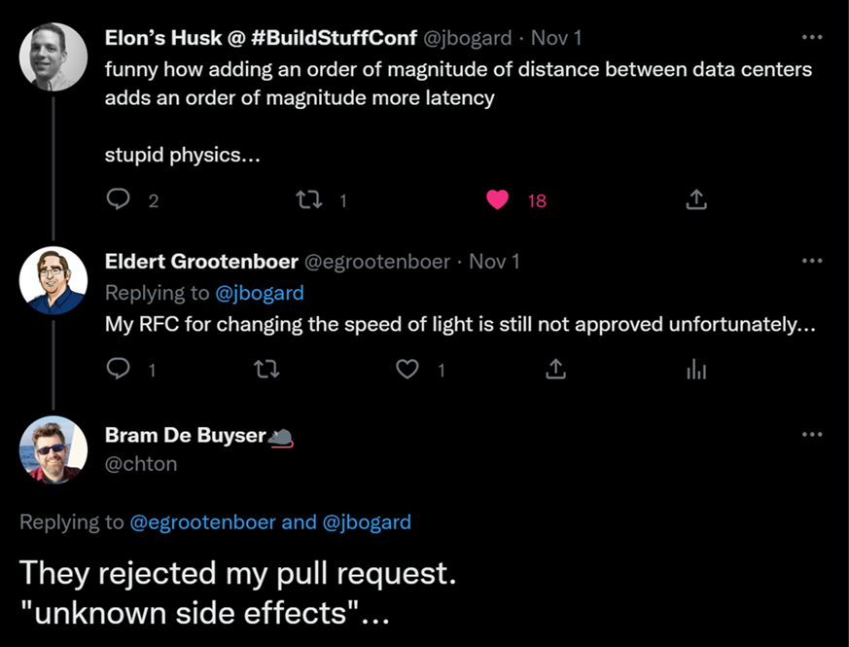
Geo data replication
Full data replication across multiple regions
Synchronous and asynchronous replication
Manual failover with telemetry
Notes:
Implement data replication across regions for data and metadata
Expand the current capabilities of the GeoDR feature to also include metadata.
Use any region
Customer can configure failover to any region they want.
Multiple failover regions
Allow customers to set multiple failover regions, providing them with the option to remain highly available even after failover. Data will be replicated between all regions.
Customer can failover to any healthy region
Customers can initiate failover at any time to a healthy region. This will also allow them to fail back to a previous primary region, once this region is healthy again.
Provide choice between strong and eventual consistency
Customer can decide between strong and eventual consistency.
Strong consistency requires at least 3 replicas
We use quorum-based commits with strong consistency, meaning that a majority of replicas need to acknowledge an operation before acknowledging the result to the client. A majority is calculated as (number of replicas / 2) + 1. This will result in a RPO 0 scenario.
Configure maximum RPO for eventual consistency
When using eventual consistency, the customer can configure the maximum RPO.
Provide telemetry around healthiness of secondary replicas
Implement telemetry indicating if the secondary replicas are healthy or have issues. This way the user can set up an alert and decide on follow-up actions.
Lagging replicas are caught up when becoming healthy again
If a secondary replica is lagging on the primary replica, this will be reported to the user through telemetry. If the user decides to wait, and the secondary replica becomes healthy again, it will be caught up to the current state of the primary replica.
Seamless failover
Failover should be seamless for clients. This is done by having a single FQDN clients connect to, which will automatically point to whichever is the primary replica at that point.
Manual failover
We allow customers to initiate a manual failover. This will give them full control over when they want to failover, allowing them to coordinate this with failover of other components. Moreover, this will provide the possibility to do disaster recovery testing.
Support for active / passive setup
The secondary replicas are passive only, customers will not be able to read or write in these regions.
Provide siphoning options on failover
When initiating failover, the customer can indicate the way they want to siphon messages from the primary to the secondary region. Options will include siphoning during failover (synchronous, with maximum grace period), after failover (asynchronous), or skip siphoning.
RTO of 1 minute
We will aim to keep the RTO as low as possible, with a maximum of one minute. This means that from the moment a failover is triggered, the customer can experience at most one minute of their namespace not being available. If the customer choses to do synchronous siphoning, the RTO is one minute plus the configured grace period.
Replicate entire configuration
We replicate the complete configuration of a namespace including, but not limited to, network configuration, authentication, scaling, RBAC, encryption configuration, etc.
Metrics are emitted on replica level
All metrics should be shown on a replica level instead of a namespace level. This allows the user to identify the performance and healthiness of each replica.
Emit Event Grid events on health changes and failover
When the health state of a region changes, an event will be sent out to Event Grid. This allows customers to initiate actions on this. Additionally, send out an event when a failover has been initiated. This could especially be interesting when combined with automatic failover, as it could trigger failover of other components.
Enable GeoDR on existing namespaces
Initially GeoDR will be enabled on new namespaces only. However, before going into GA, we need to allow customers to enable this on their existing namespaces. Customers using this type of feature usually can’t move their clients over easily to a new namespace.
Support for active / active-passive setup
Both the primary and secondary regions can be used for reads. Only the primary region can be used for writing. Configuration will be pushed from the primary region.
Support for active / active setup
Both the primary and secondary regions can be used for reading and writing. Written data will be synchronized between all regions. Configuration will be pushed from the primary region.
For example, the telemetry that is used internally to decide if we need to switch to another availability zone.
@Eldert - Good to define RPO, RTO etc.
Done.

Slide 15

Peek message by state
Peek messages in specific state
Expose message state when peeking
Allows for better scaling options
Notes:
Functions, KEDA

Slide 16

DLQ batch delete
Delete messages in batches
Improved performance over receive and delete
First focus is on dead letter queue
Integrated with Service Bus Explorer
Possibly further evolvement into full purge

Slide 17

Roadmap

Slide 18
Still in early phase!
No timelines to share yet, no promises being made, still in design phase
Things will change as we go forward
Your input is most welcome

Slide 19

Subscription metrics
Provide metrics on topic-subscription level
Can be used in alerts and dashboards
Auto-scale on subscription length
Notes:
Emit metrics from subscriptions
We will emit the same metrics on subscriptions as we do for queues and topics.
Use metrics for monitoring
The subscription metrics will be used for monitoring scenarios, such as creating alerts.
Use metrics for auto-scale operations
Auto-scale can be configured to use the metrics from subscriptions.
Show metrics in blade for subscription
On the subscription blade it will show on its corresponding blade.

Slide 20

Delayed Abandon
Abandon with option to specify a DateTime
Only needs receive permissions
Delayed messages are placed at the back of the entity
Notes:
Introduce more granular RBAC permissions
Introduce specific permissions for being able to see the content and custom headers of messages, as well as a permission to execute operations.
Use new RBAC permissions when on the APIs
The APIs should only return the data which is allowed according to their permissions. Operations for which they don’t have permissions should be blocked.
Scope RBAC permissions to a specific entity
Allow the permissions to be set on a specific queue, topic, or subscription.
Service Bus Explorer should show why certain content is not retrieved
If content or custom headers are not retrieved in Service Bus Explorer due to lack of permissions, a clear message should be shown to the user.
Service Bus Explorer should disallow operations which are not permitted
When certain operations are not allowed, they should be disabled in Service Bus Explorer.
Add filtering to REST APIs for retrieving entities
Expand List REST APIs with option to filter on name.
Entities will be sorted by name
When retrieving the entities, we will get these sorted by name.
Works together with pagination
If many entities fit the used filter, we will load them in a paginated way, by using the $top and $skip query parameters.

Slide 21

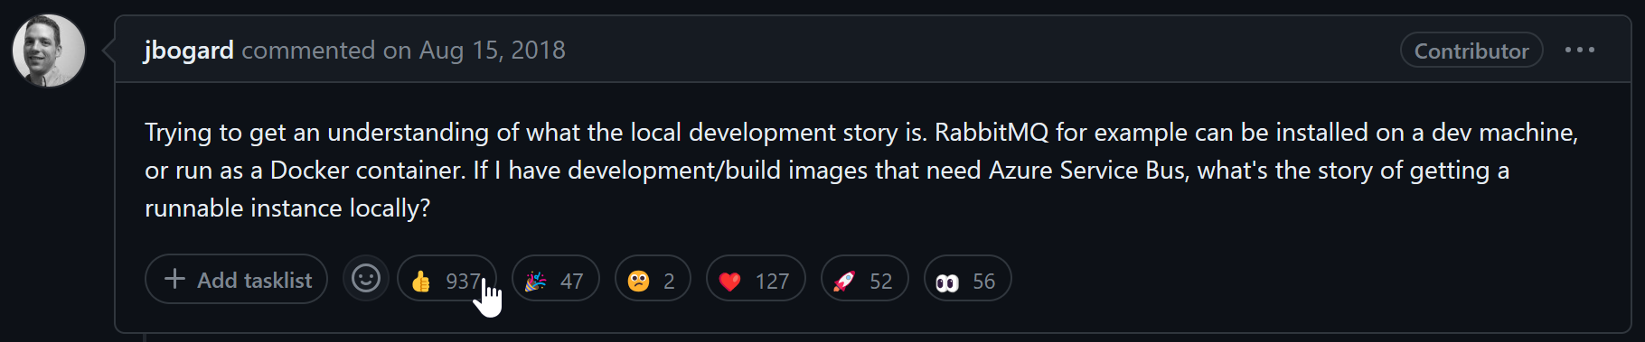
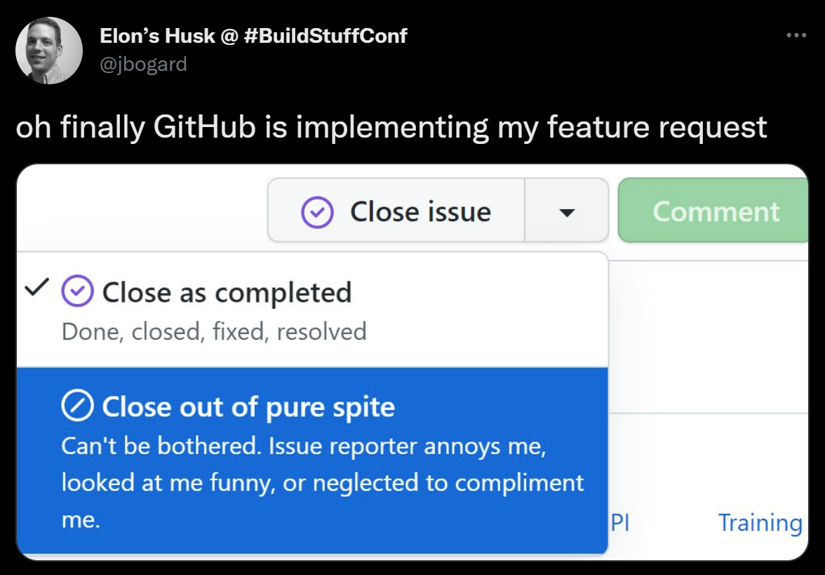
Local emulator
Notes:
Controversial - Provide a local runtime for Service Bus
Create a local emulator for Service Bus which can be used for development and testing purposes. We will support queues and topics & subscriptions in the emulator.
Capable of running from a test pipeline
The emulator can spin up very fast, allowing customers to run this from their test pipelines for their unit and integration tests.
Provide basic features needed during development and testing
We will provide the basic functionality which makes sense for development and testing purposes. These features consist of the below.
Send and receive messages
Dead lettering
Pub-sub routing and filtering
Batching
API compatible
To allow our different SDKs to work with the emulator, it should be API compatible with the cloud API, both for management and messaging capabilities. For messaging capabilities, we should support the AMQP over web sockets protocol for this.
Single namespace
We will emulate a single namespace, which will hold the different entities. Customers will not be able to create multiple namespaces.
Messages in memory
As the focus here is on development and testing scenarios, we will store the messages in memory. This means that when the emulator gets restarted, all messages will be lost.
Limit usage
As the focus here is on development and testing scenarios, we will introduce limitations accordingly. As such, we will use the limits as specified below.
80GB maximum entity size
Connection limits
Net Messaging: 1000
AMQP: 5000
5000 concurrent receive requests per entity
1000 queues or topics
2000 subscriptions per topic
100,000 correlation filters per topic
100MB maximum message size
Persistence for entities
Entities should be persisted, meaning that on restart of the emulator the configures entities are still available.
Containerized
To allow the emulator to be run easily in test pipelines, our first focus will be on getting a containerized version out.
Cross-platform
The emulator should be able to run cross platform, most notably Windows, Linux, and MacOS.
Sustainable
New features should be easy to integrate with the emulator. This should be done with minimal effort, meaning we need to ensure that the architecture we create for the emulator allows to re-use the code we write for the cloud service.
System requirements
The emulator should be able to run on a modern developer’s system.
Respond when using unsupported features
If customer uses a feature which is not supported by the emulator, a clear message indicating this should be sent back in the response.
Provide advanced features needed during development and testing
We will provide more advanced functionality which makes sense for development and testing purposes. These features consist of the below.
Duplicate detection
Message sessions
Scheduled delivery
Message expiration (TTL)
Message deferral
Actions on topic subscriptions
Large message support
Shared Access Signature authentication
Integration with development tools
Integrate the emulator in local development tools. Our first focus here should be VS Code, with Visual Studio as a second target.
Metrics
Provide simplified metrics in the emulator. This will help to ensure developers that their messages are properly sent and received..
Standalone binary
The emulator should have a standalone binary next to a containerized version. This allows users to easily run the application, without the need for a container host.
Provide niche features needed during development and testing
We will provide more advanced functionality which makes sense for development and testing purposes. These features consist of the below.
Transactions
Auto-delete on idle
Auto-forwarding
Batched delete
Queue purge
OAuth authentication
JMS 1.1 and 2.0 compatibility

Slide 22
Local emulator
Cross-platform, containerized experience for development and testing purposes
Run locally and from test pipeline
Provides functionality which makes sense for dev/test
Notes:
1221
Controversial - Provide a local runtime for Service Bus
Create a local emulator for Service Bus which can be used for development and testing purposes. We will support queues and topics & subscriptions in the emulator.
Capable of running from a test pipeline
The emulator can spin up very fast, allowing customers to run this from their test pipelines for their unit and integration tests.
Provide basic features needed during development and testing
We will provide the basic functionality which makes sense for development and testing purposes. These features consist of the below.
Send and receive messages
Dead lettering
Pub-sub routing and filtering
Batching
API compatible
To allow our different SDKs to work with the emulator, it should be API compatible with the cloud API, both for management and messaging capabilities. For messaging capabilities, we should support the AMQP over web sockets protocol for this.
Single namespace
We will emulate a single namespace, which will hold the different entities. Customers will not be able to create multiple namespaces.
Messages in memory
As the focus here is on development and testing scenarios, we will store the messages in memory. This means that when the emulator gets restarted, all messages will be lost.
Limit usage
As the focus here is on development and testing scenarios, we will introduce limitations accordingly. As such, we will use the limits as specified below.
80GB maximum entity size
Connection limits
Net Messaging: 1000
AMQP: 5000
5000 concurrent receive requests per entity
1000 queues or topics
2000 subscriptions per topic
100,000 correlation filters per topic
100MB maximum message size
Persistence for entities
Entities should be persisted, meaning that on restart of the emulator the configures entities are still available.
Containerized
To allow the emulator to be run easily in test pipelines, our first focus will be on getting a containerized version out.
Cross-platform
The emulator should be able to run cross platform, most notably Windows, Linux, and MacOS.
Sustainable
New features should be easy to integrate with the emulator. This should be done with minimal effort, meaning we need to ensure that the architecture we create for the emulator allows to re-use the code we write for the cloud service.
System requirements
The emulator should be able to run on a modern developer’s system.
Respond when using unsupported features
If customer uses a feature which is not supported by the emulator, a clear message indicating this should be sent back in the response.
Provide advanced features needed during development and testing
We will provide more advanced functionality which makes sense for development and testing purposes. These features consist of the below.
Duplicate detection
Message sessions
Scheduled delivery
Message expiration (TTL)
Message deferral
Actions on topic subscriptions
Large message support
Shared Access Signature authentication
Integration with development tools
Integrate the emulator in local development tools. Our first focus here should be VS Code, with Visual Studio as a second target.
Metrics
Provide simplified metrics in the emulator. This will help to ensure developers that their messages are properly sent and received..
Standalone binary
The emulator should have a standalone binary next to a containerized version. This allows users to easily run the application, without the need for a container host.
Provide niche features needed during development and testing
We will provide more advanced functionality which makes sense for development and testing purposes. These features consist of the below.
Transactions
Auto-delete on idle
Auto-forwarding
Batched delete
Queue purge
OAuth authentication
JMS 1.1 and 2.0 compatibility

Slide 23

Almost done…

Slide 24
Takeaways
Built for reliability and resilience
We are continuously evolving
Provide your feedback
Notes:
Stability, scalability, security, low latency, availability
We always listen to the customer, that doesn’t mean we always create what they ask for
Poll
Customer feedback page
GitHub

Slide 25

Provide your feature requests
https://aka.ms/SBFeatures

Slide 26
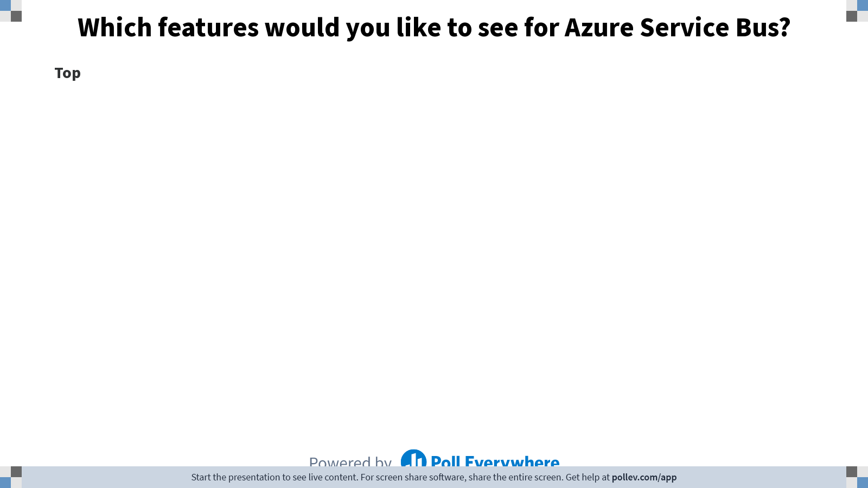
Notes:
Poll Title: Do not modify the notes in this section to avoid tampering with the Poll Everywhere activity. More info at polleverywhere.com/support Which features would you like to see for Azure Service Bus? https://www.polleverywhere.com/discourses/Lgx22aNlob3ifiKOUyXoJ

Slide 27

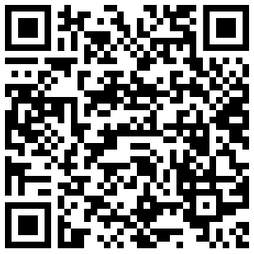




Thank you!
@egrootenboer
servicebuspm@microsoft.com
https://www.linkedin.com/in/eldert-grootenboer
https://aka.ms/AzureServiceBus-Feedback

